Slide 1
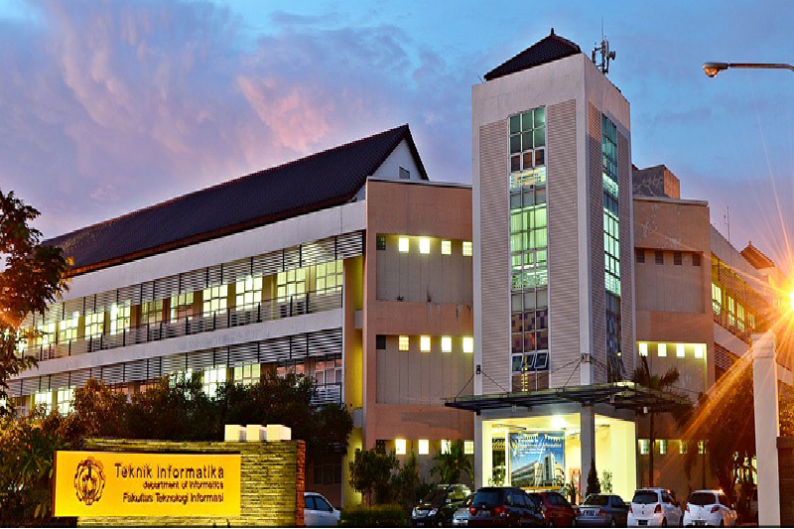
Chapter One
Backgrounds, Pusposes and Benefits
MAIN PRESENTATION
Desain dan Analisis Algoritma
Untuk Menyelesaikan Permasalahan Matematika Pada Situs SPOJ
Studi Kasus: GCDEX, TRENDGCD, dan INS16H
June 29, 2017
Julio Anthony Leonard
5113 100 148
Lets Start!

Slide 2
Solving Programming Problem
Backgrounds
Competition
Solving programming problem also become the model for many big competitions in the world
Job Opportunity
Solving programming problem has become requirements in applying a job
SPOJ
An Online Judge platform, one of the eldest platform that still actively used even today because of the challenging problem.
Julio A Leonard
1
Chapter

Slide 3
Purposes & Benefits
Solving Programming Problem
To Solve 3 Math Related Programming Problem
Solve SPOJ GCD Extreme, Trending GCD, and Daenerys Want to Conquer using numerical method such as Euler Totient Function, Mobius Inversion Formula, and Miller-Rabin Algorithm,
Able to Solve the Problem
By solving the problem, author able to give insight about solving math related programming
To Find Better Solution
Better solution is noted by a faster complexity meaning the
Able to Find Better Solution
The benefit of that activity is knowing how the program complexity to decide wether the solution is optimal enough or not
Julio A Leonard
1
Chapter

Slide 4
Chapter One
Backgrounds, Pusposes and Benefits
Chapter Two
About, Structure, Business Line, Man Power and Facilities

Slide 5

Conclusion
Myself
GCDEX
AT THE LAST . . .
BIGTHANKS
Status
Accepted with O(N*Log(Log(N))) Complexity
for perfectly attention in all sessions. Kindly need more attention for considering my last present as the well-value for my graduation.
Method
Give self-project for making or developing the improvement
Julio A Leonard
4
Chapter

